Slide 1
VAST: model improvements
19 April 2023

Slide 2
Motivation
Map seasonal spatial density of cod
Create seasonal indices of abundance based on combined survey efforts
Identify stock- and size-specific habitat associations

Slide 3
Objectives
Explain model setup
Share preliminary results
Feedback welcome!
Notes:
This tool is designed to estimate spatial variation in density using spatially referenced data, with the goal of habitat associations (correlations among species and with habitat) and estimating total abundance for a target species in one or more years

Slide 4
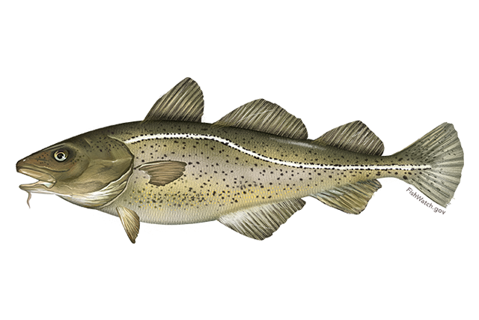
Model setup

Slide 5
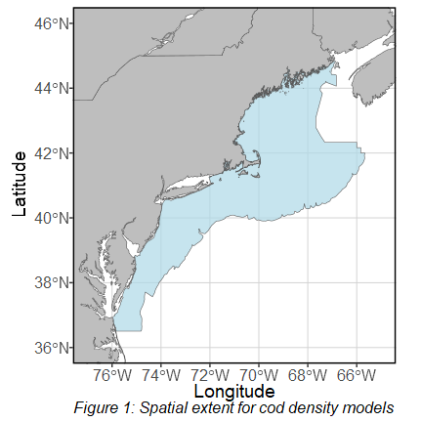
Model setup – spatial domain
Based on NEFSC bottom trawl survey strata
Appended Narragansett Bay and Block Island Sound (URI and RIDEM trawls)
Some stations removed
Anisotropy expected
200 knots
Force 2,000 grid cells: each ~25km by 25km
Can get finer, but computational time goes up exponentially

Slide 6
Model setup – response variable
VAST accepts encounter (binary), abundance (count), or biomass (real-valued) data
Not all fish were weighed at catch and therefore not all size categories have complete biomass data
All size categories have complete count data
Abundance data seems to be the best choice

Slide 7
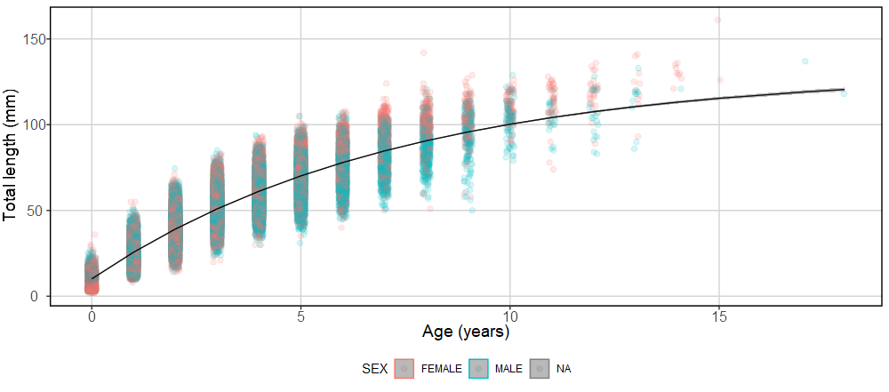
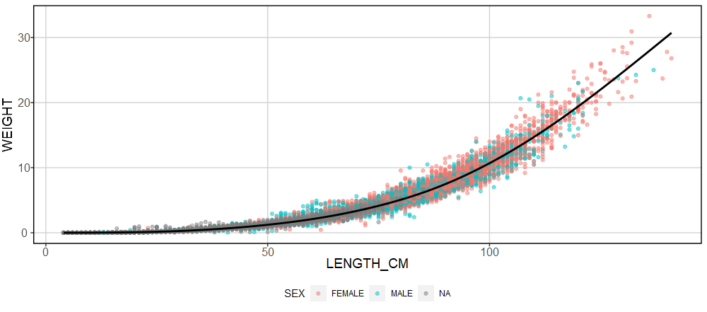
Model setup – categories
Small
Length < 39.1 cm
Medium
Length < 70.2 cm
Large
Length > 70.2 cm
Unknown ages
Surveys without biological data
Surveys that subset catch
Eventually excluded, or else model does not converge

Slide 8
Model setup – gear sensitivity
Surveys include mostly bottom trawl surveys, but we can also incorporate one bottom longline survey and one inshore jigging survey
Question from previous meeting: how sensitive is VAST to differences in catchability arising from these varied gears?
To answer: ran and compared four basic models
All surveys (including BLLS and Sentinel jigging)
Only trawl surveys
All trawl surveys + BLLS
All trawl surveys + Sentinel jigging

Slide 9
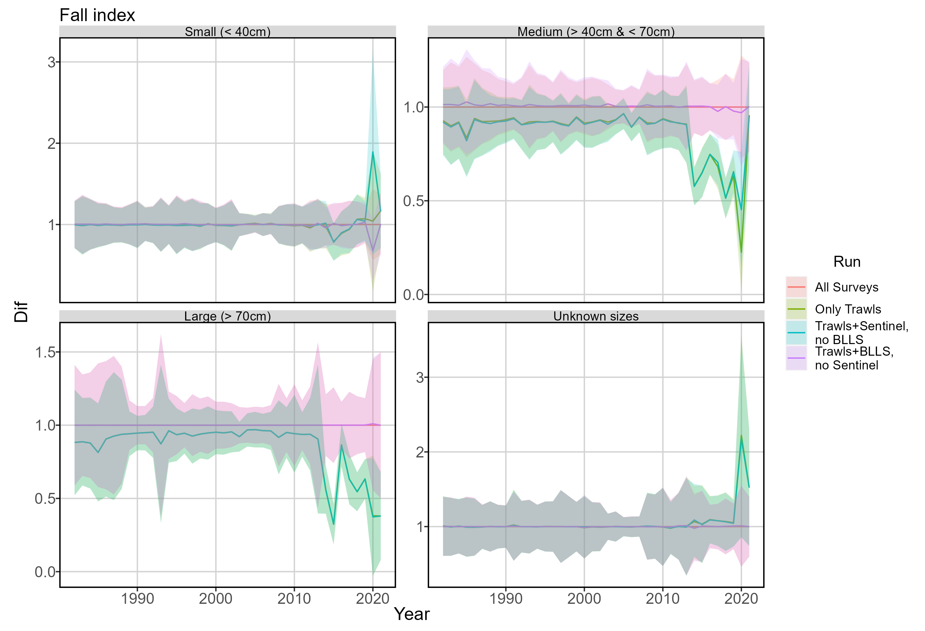
Model setup – gear sensitivity

Slide 10
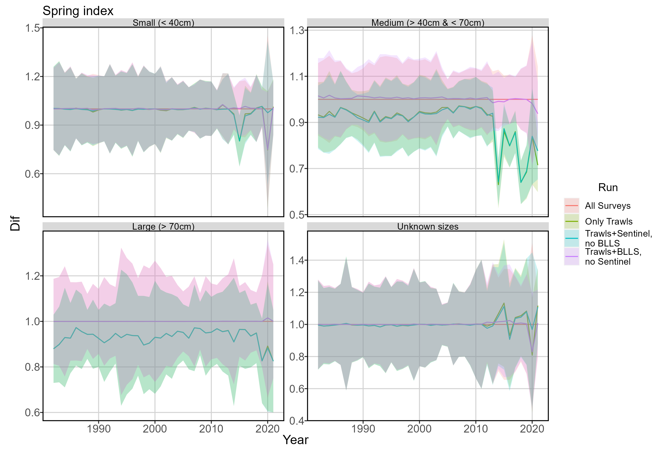
Model setup – gear sensitivity

Slide 11
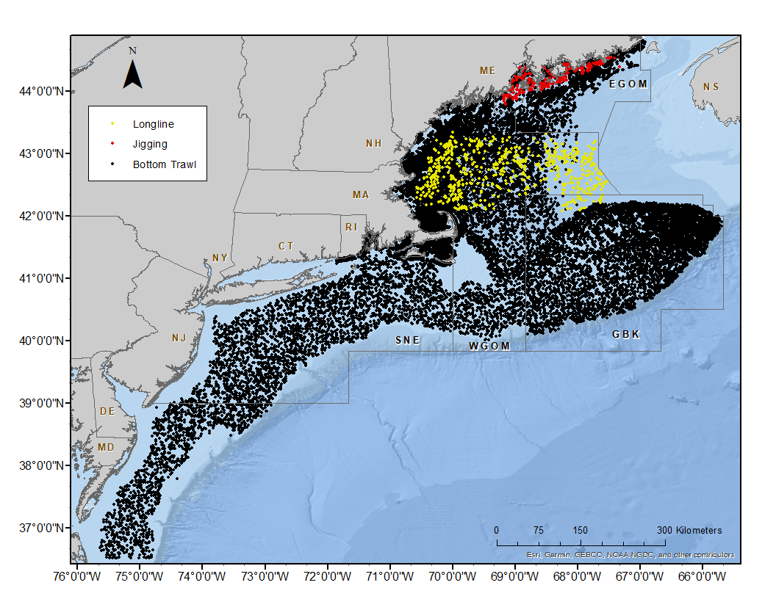
Model setup – effort
Gear sensitivity analysis indicates we can drop Sentinel survey
Can calculate or have estimates of area swept for all trawl surveys
Per McElroy (2019), BLLS set up to imitate BTS effort– so in model, we use BTS area swept estimates for BLLS effort.

Slide 12
Model setup – density covariates
Density covariates must have a value at every location within the spatial domain
Removes a few stations very close to shore
Current possible covariates:
Sediment type: sand, mud, gravel, cobble, rock
Rugosity
Bathymetry
Bottom temperature and OISST-derived surface temperature
Climate indices: NAO, AMO
Cubic spline additive model for both predictors
Response variable ~ cs(Density Covariate 1) + … + cs(Density Covariate n)

Slide 13
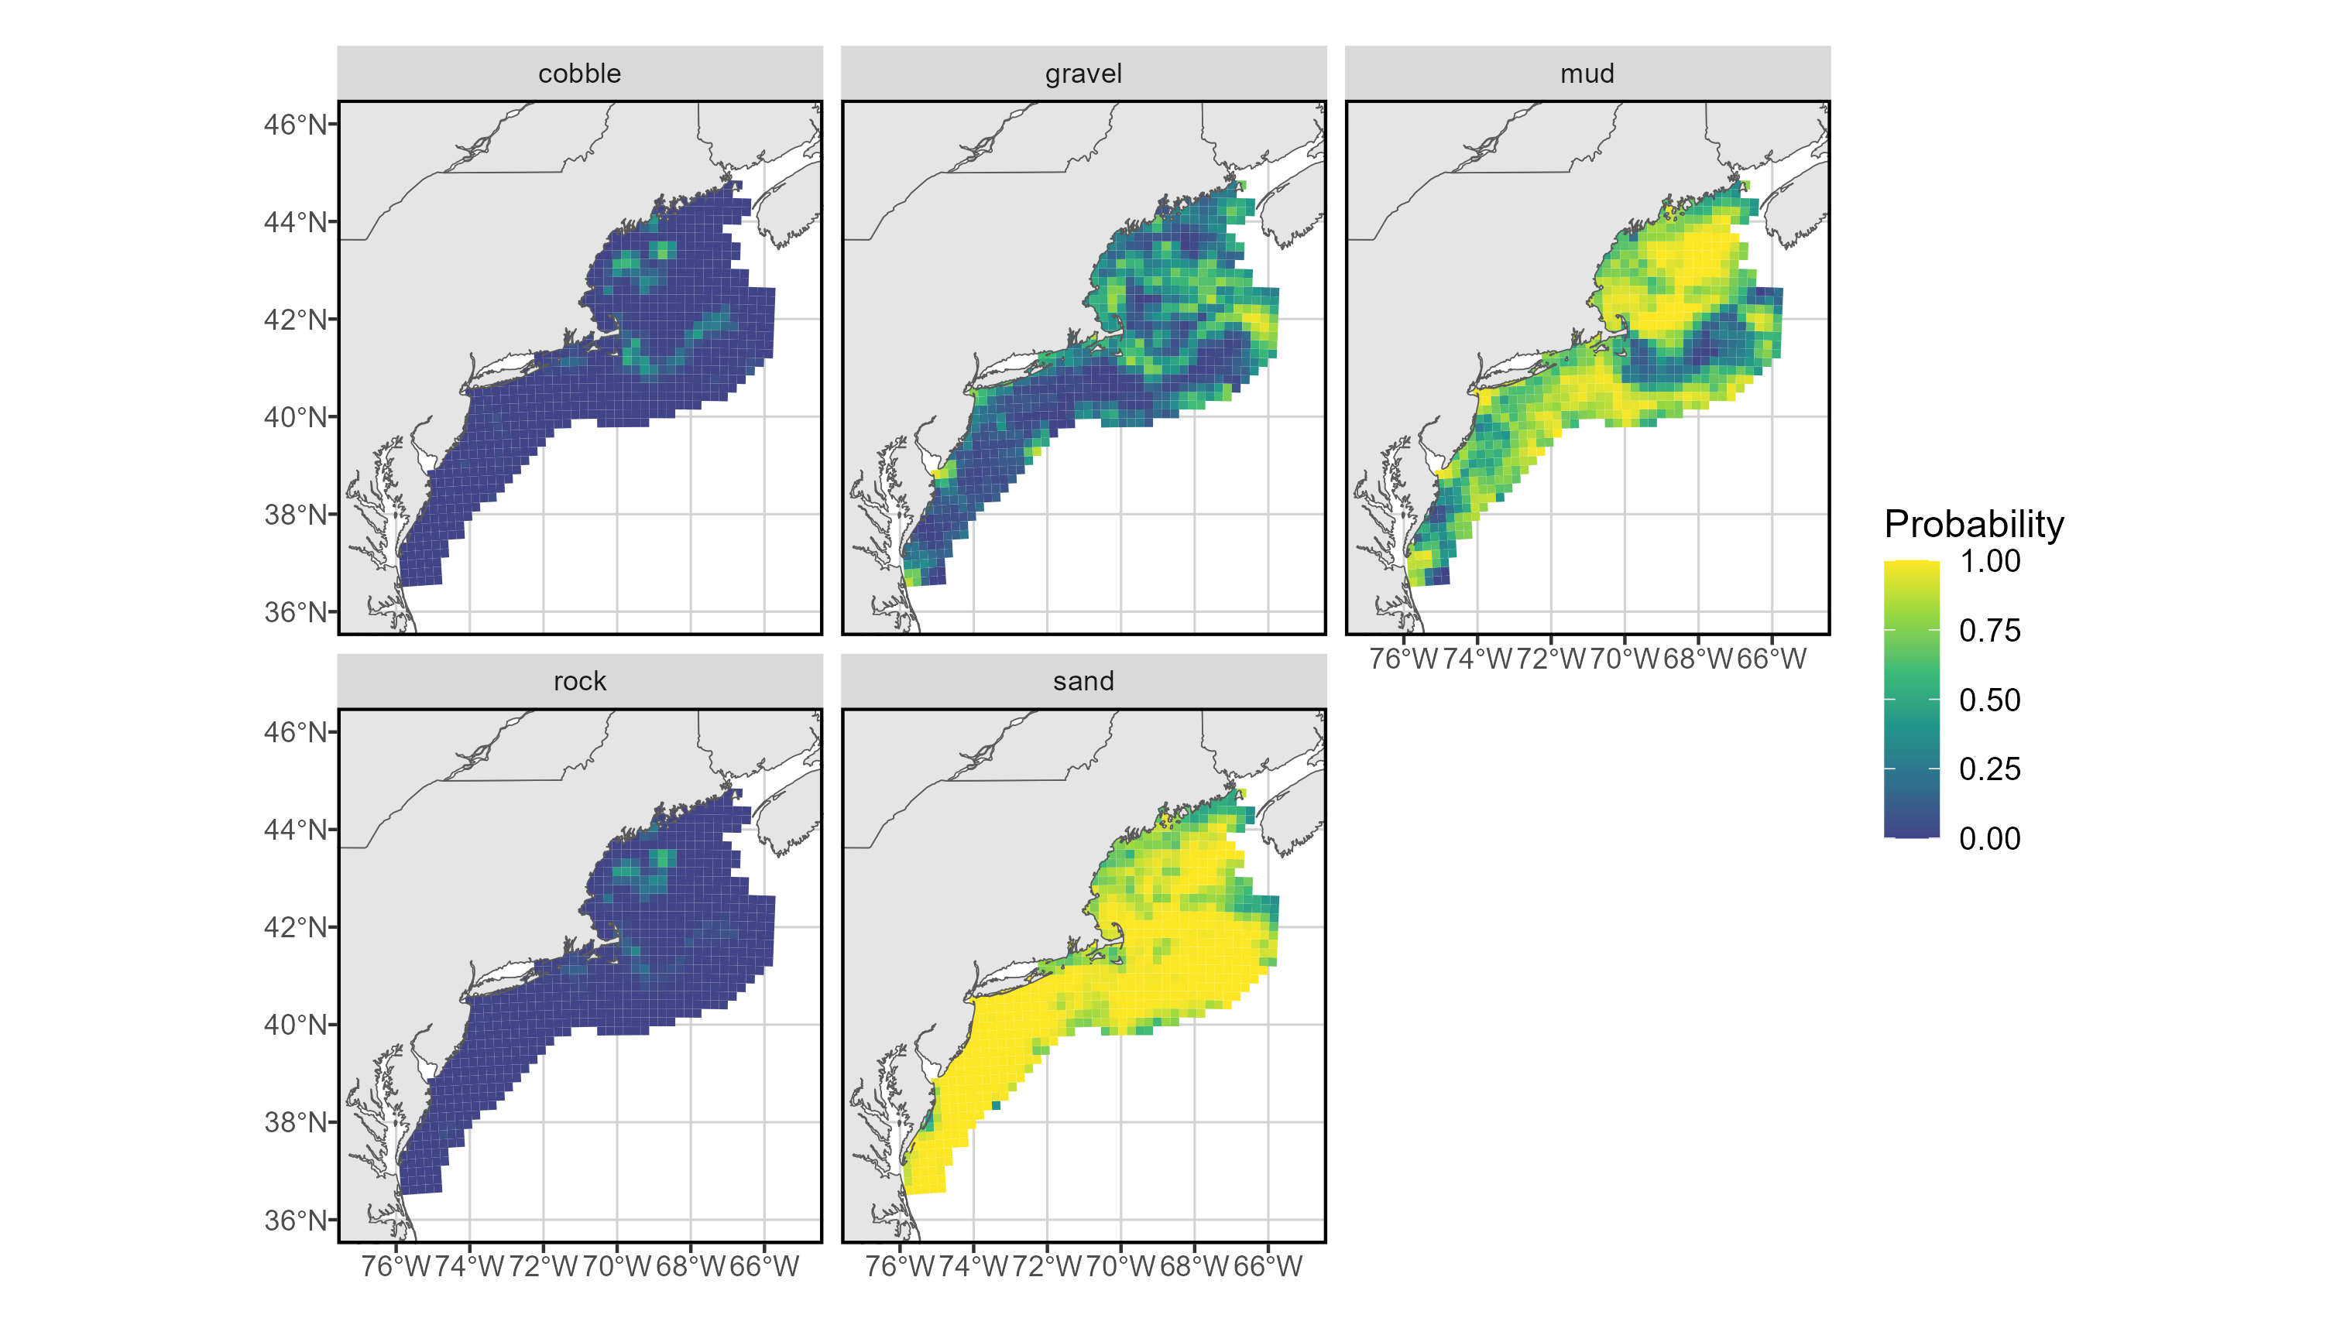
Model setup – density covariates

Slide 14
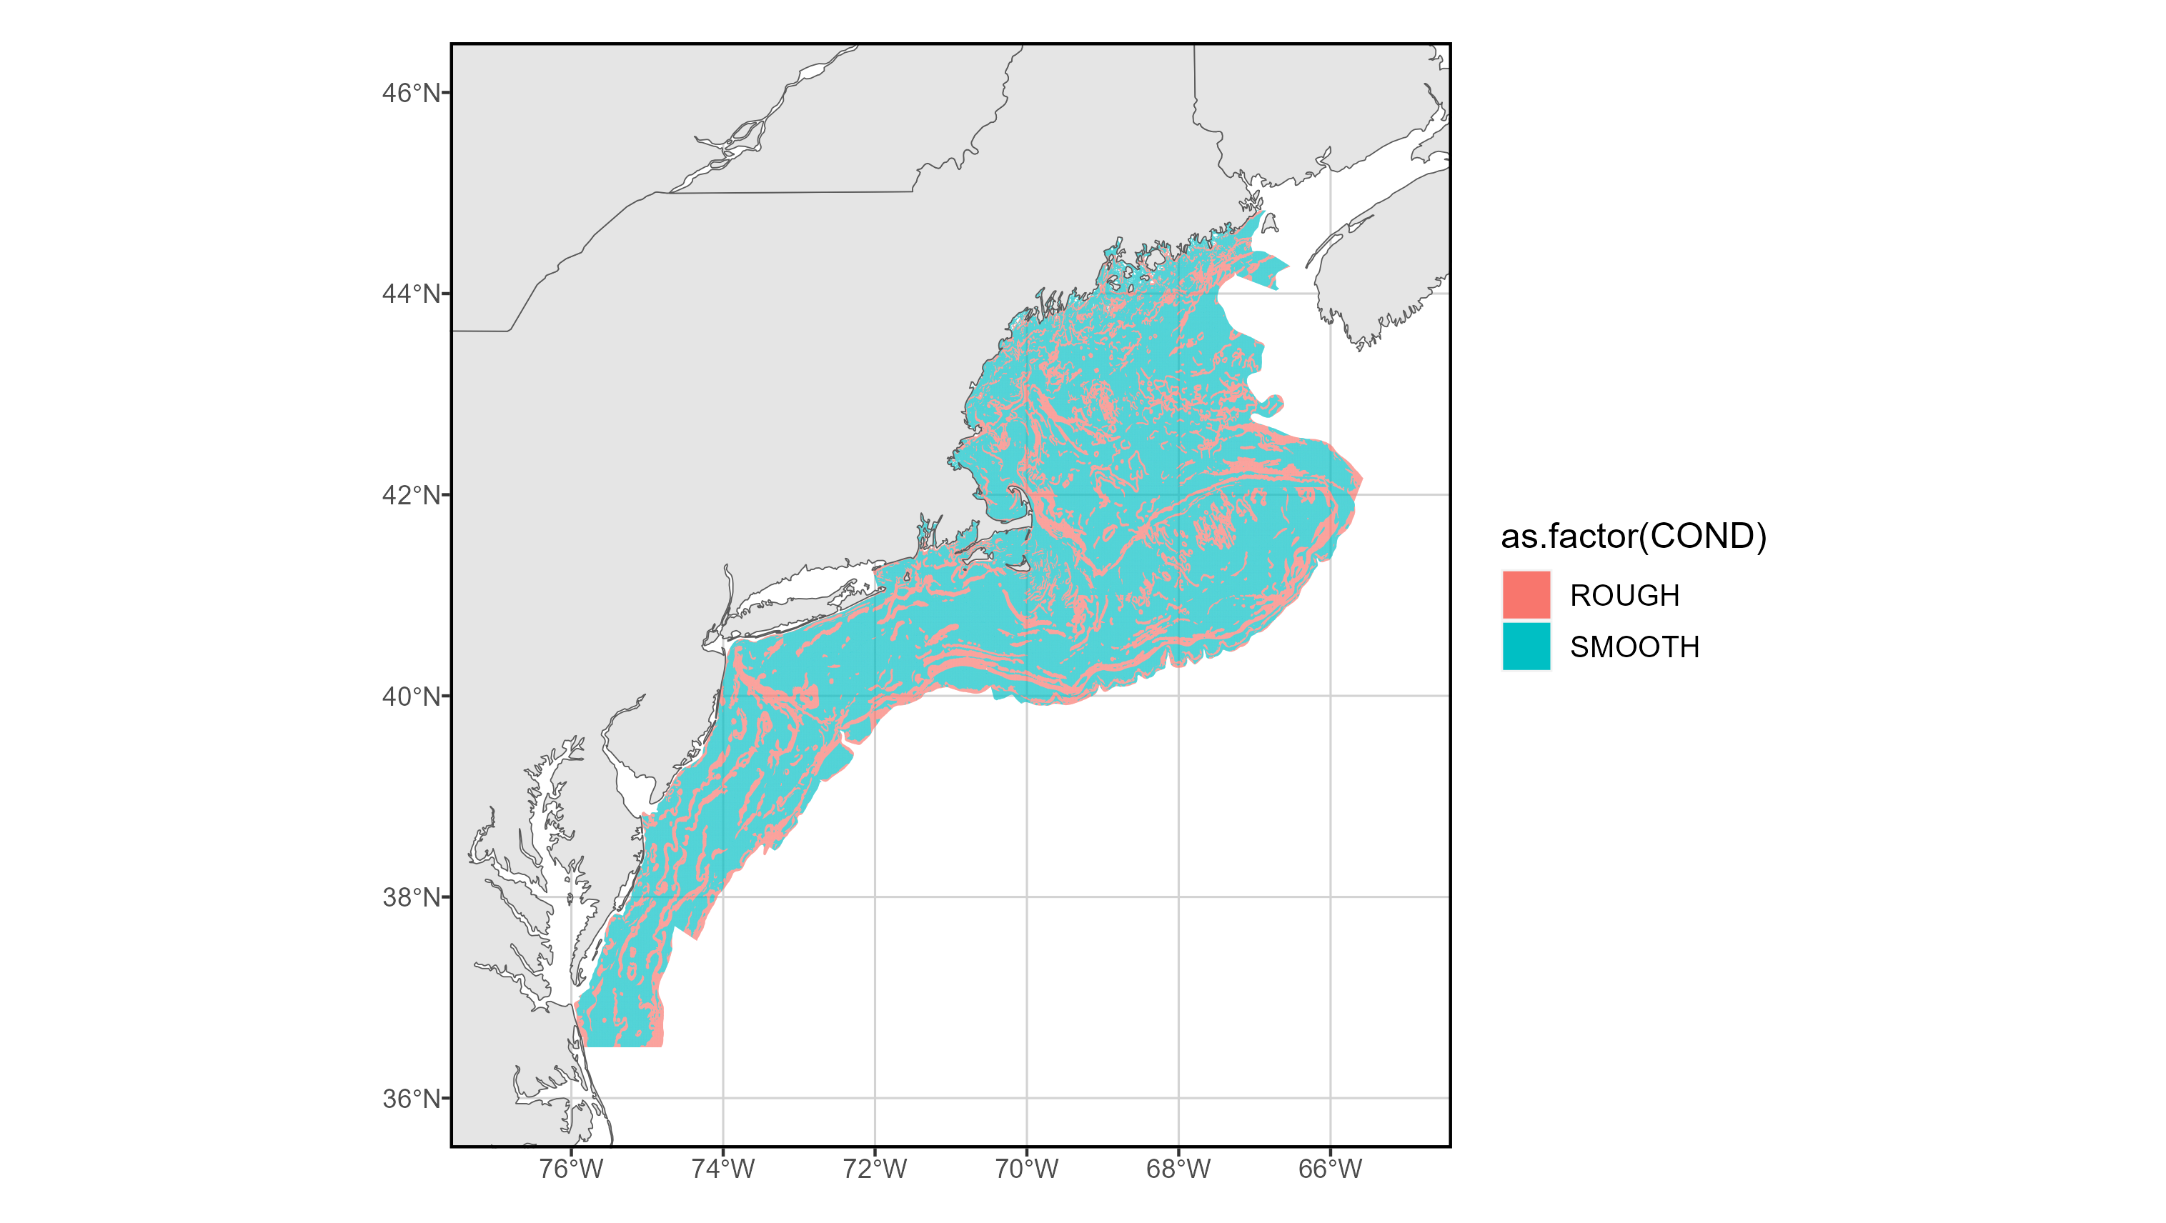
Model setup – density covariates

Slide 15
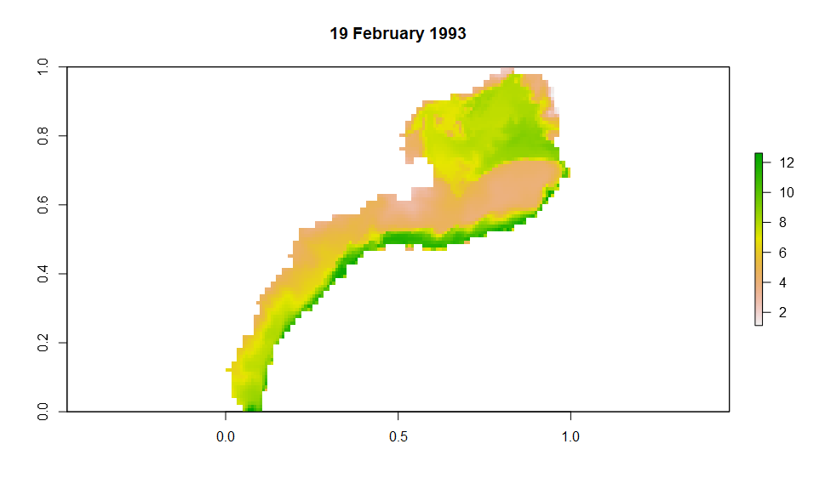
Model setup – density covariates
Extended inshore through focal windows (using the mean nearby temperature to predict unknown temperatures
Extended temporally through 2021 by repeating 2020 values (probably not the best)

Slide 16
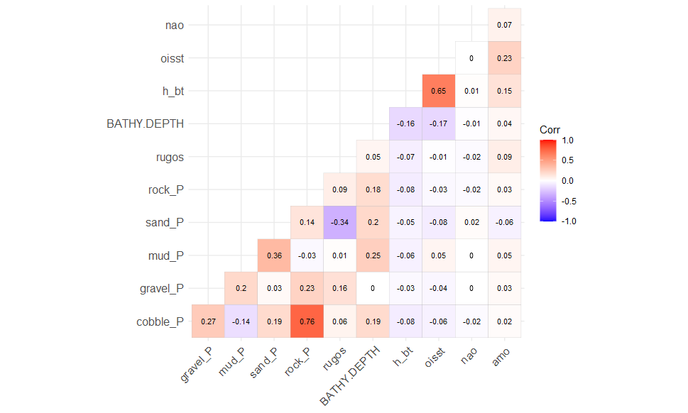
Model setup – density covariates

Slide 17
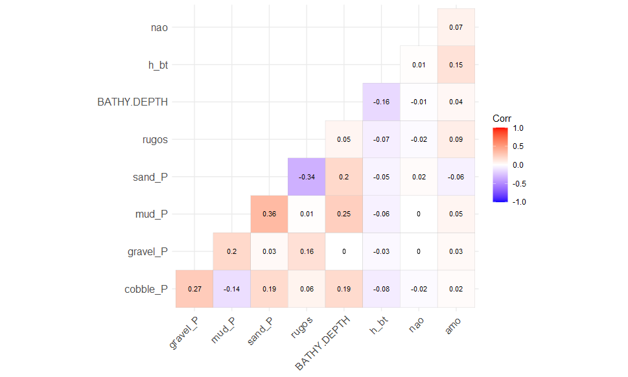
Model setup – density covariates

Slide 18
Model selection
Model selection stage 1: model components
AIC model comparison
Model with anisotropy and all spatial/ spatio-temporal components selected as most appropriate
Model selection stage 2: density covariates
AIC model comparison
I need to rerun this, I have changed from a linear model to a cubic spline model.

Slide 19
Model setup – spatial and spatio-temporal variation
Defined by multiple model components for 1st and 2nd linear predictors
1st linear predictor: encounter
2nd linear predictor: catch rate
Distribution:
Catch rates: Delta-Lognormal, using bias-corrected-mean and log-coefficient of variation as parameters
Encounter rates: Alternative "Poisson-link delta-model" using log-link for numbers-density

Slide 20
Preliminary results

Slide 21
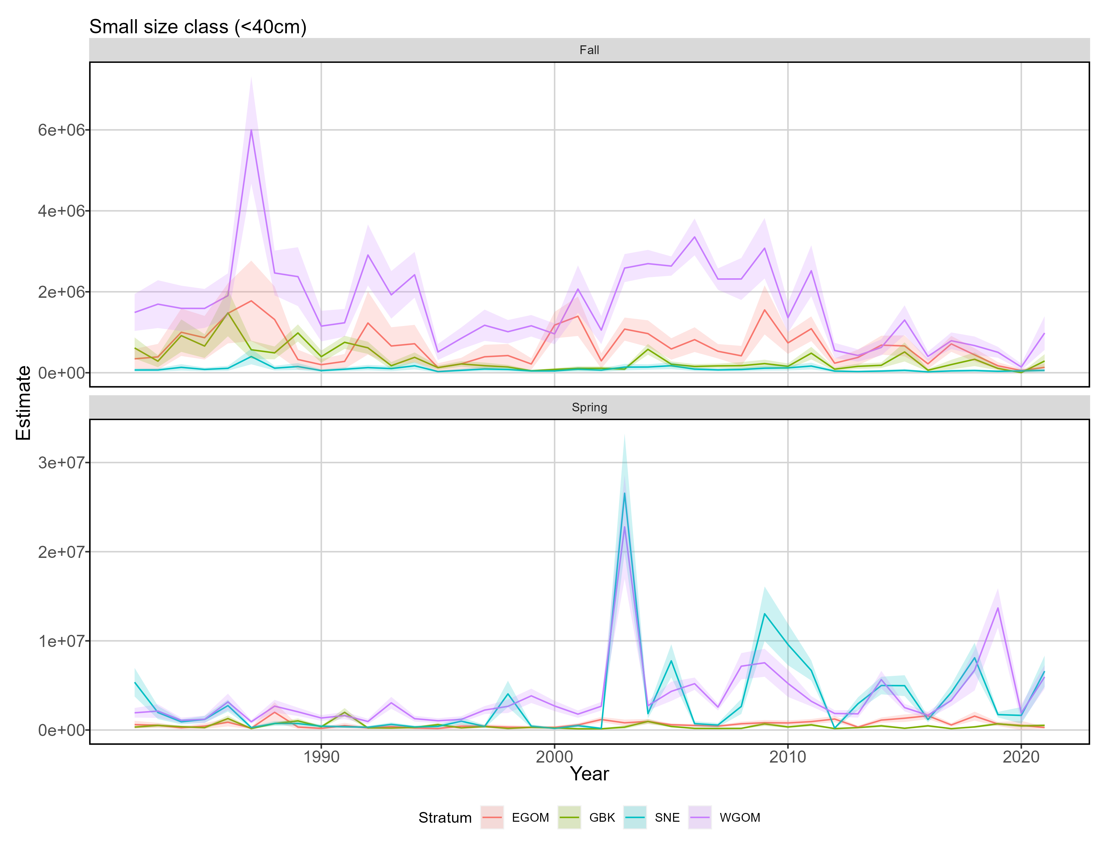
Split indices of abundance

Slide 22
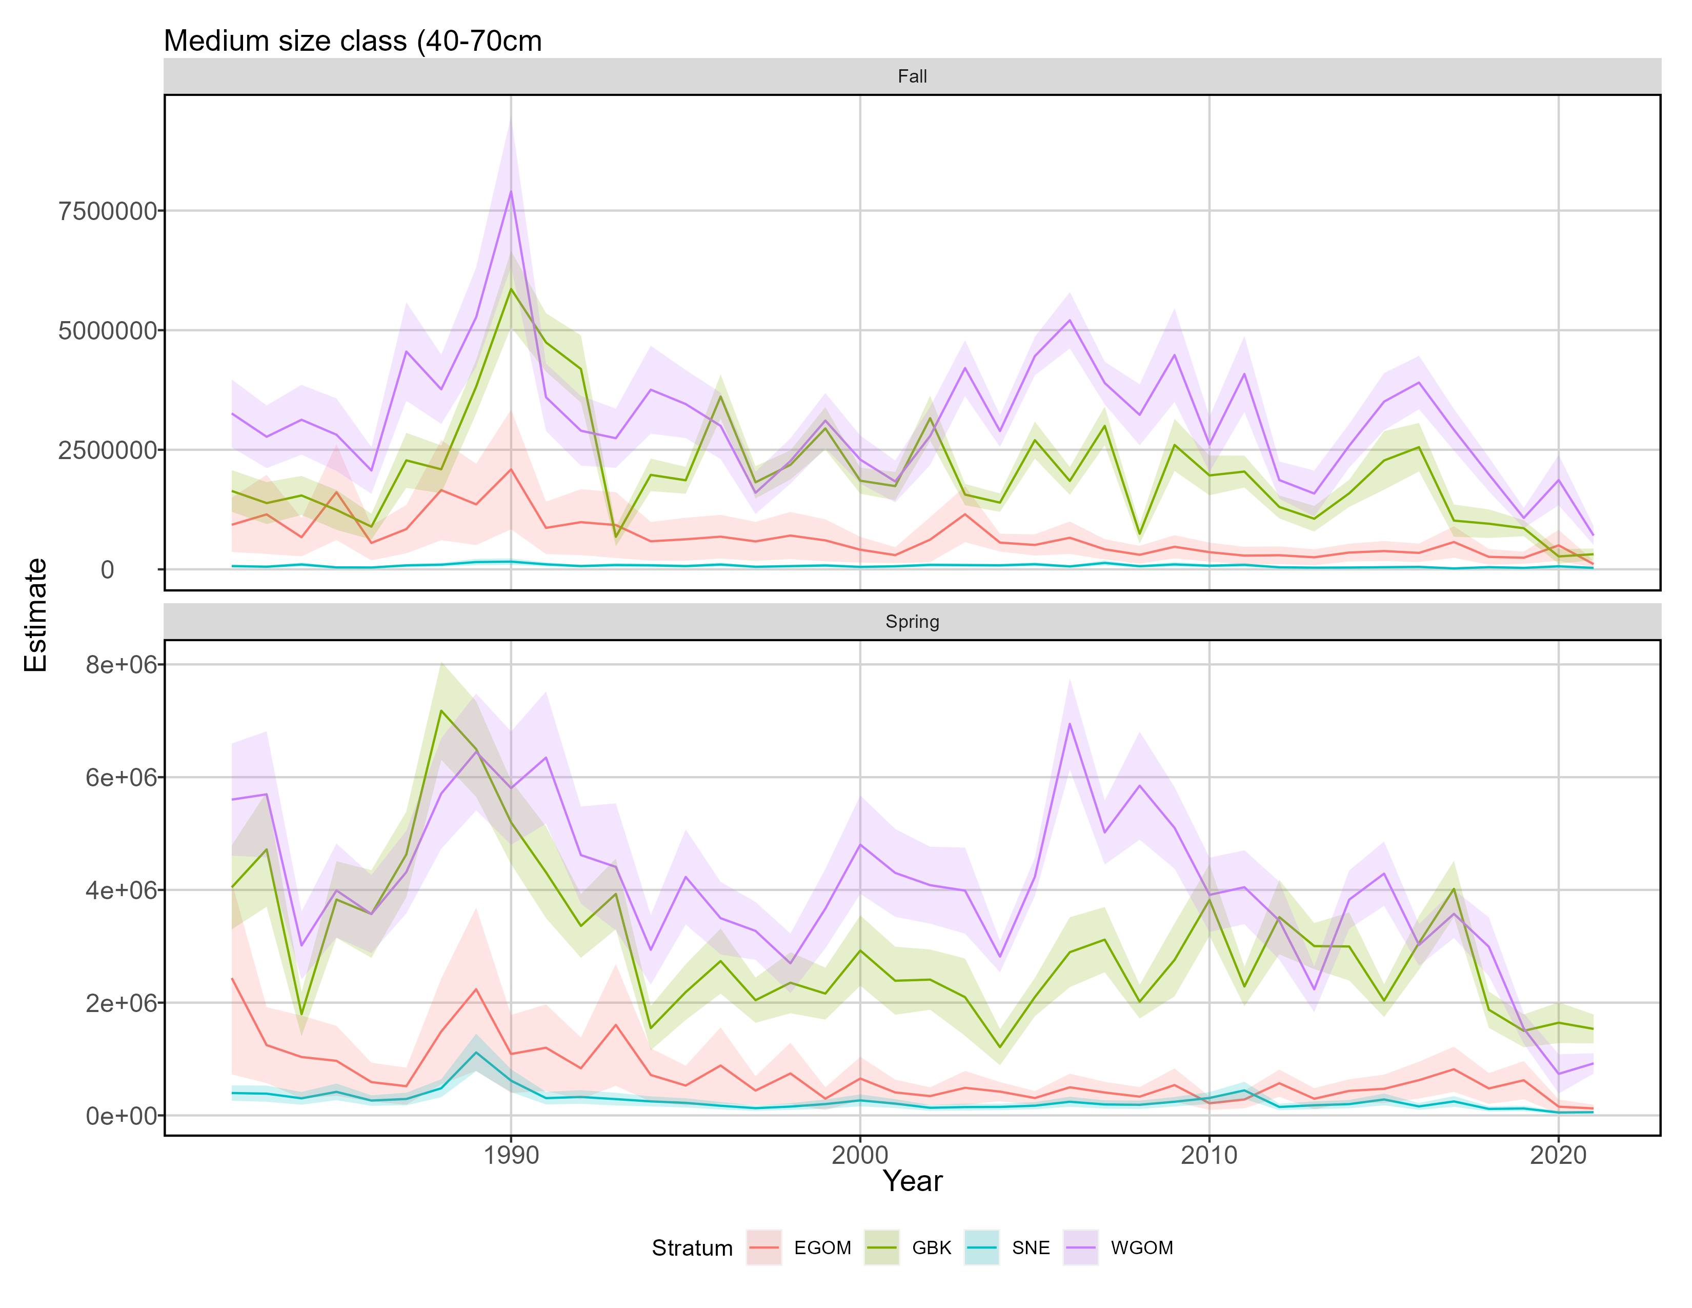
Split indices of abundance

Slide 23
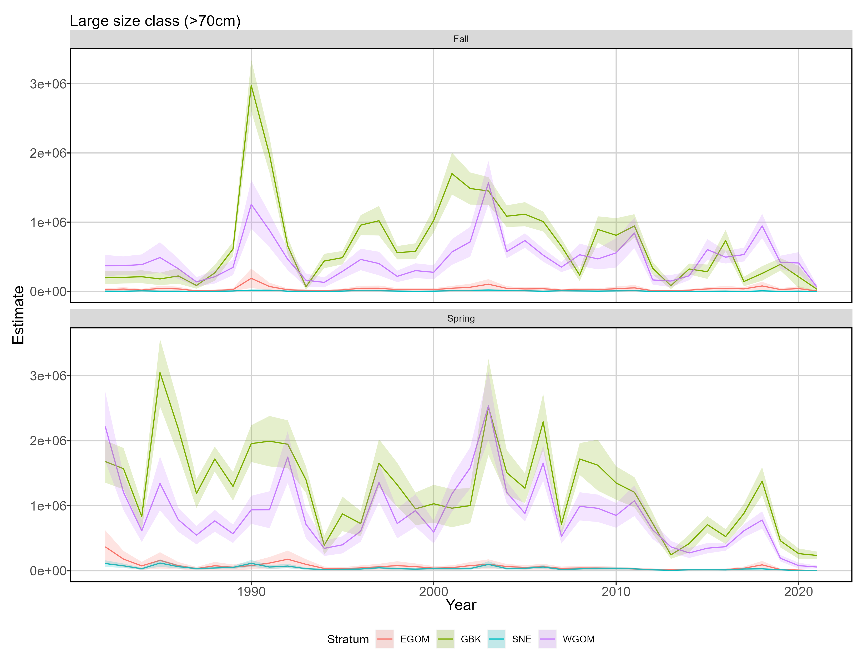
Split indices of abundance

Slide 24
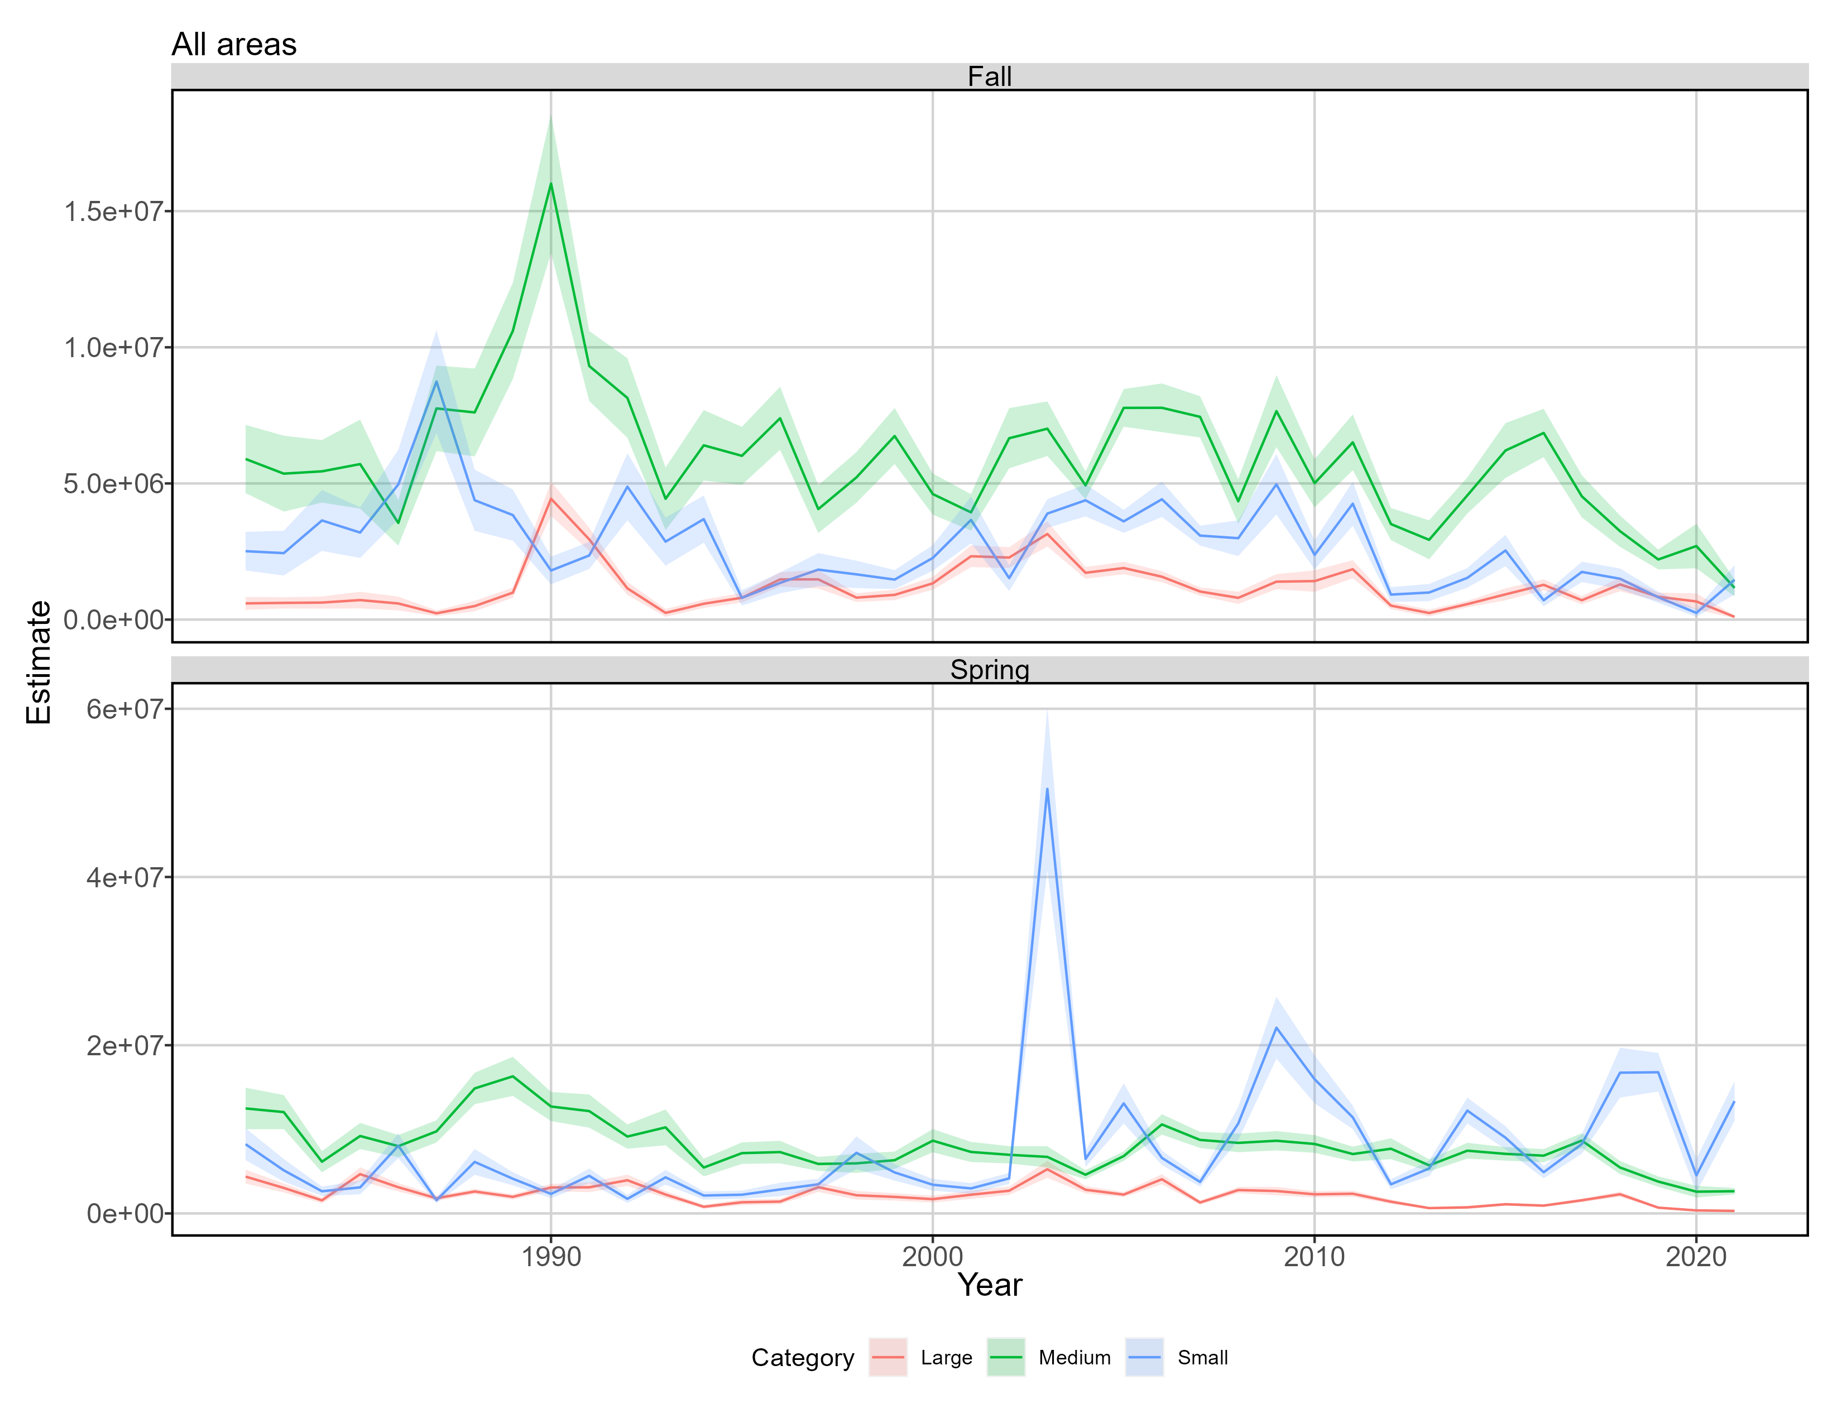
Split indices of abundance

Slide 25
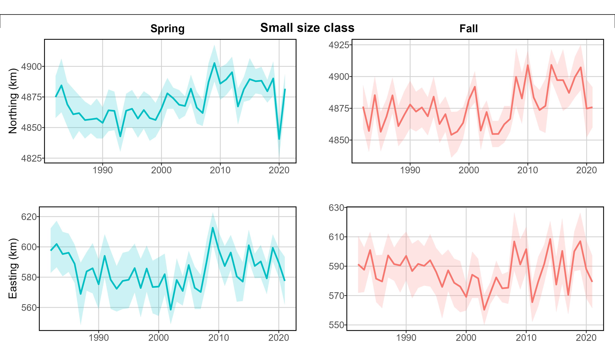
Split effective area occupied

Slide 26
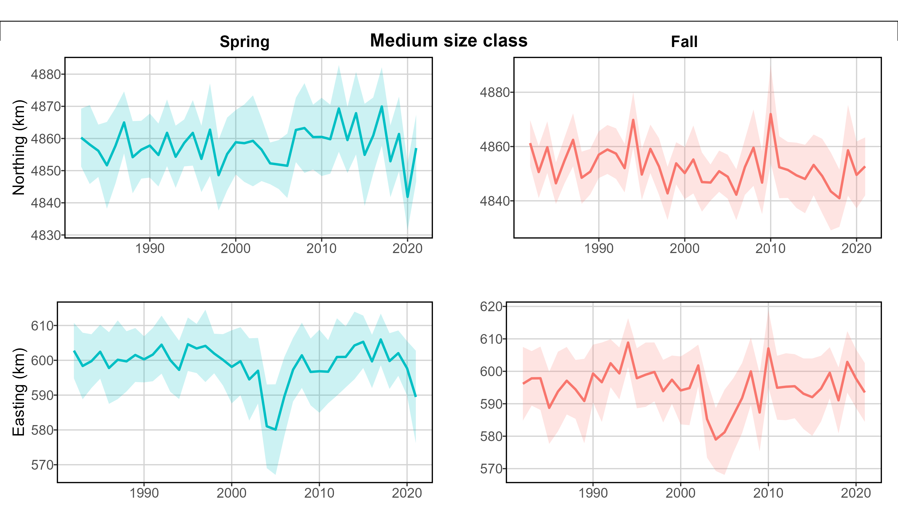
Split effective area occupied

Slide 27
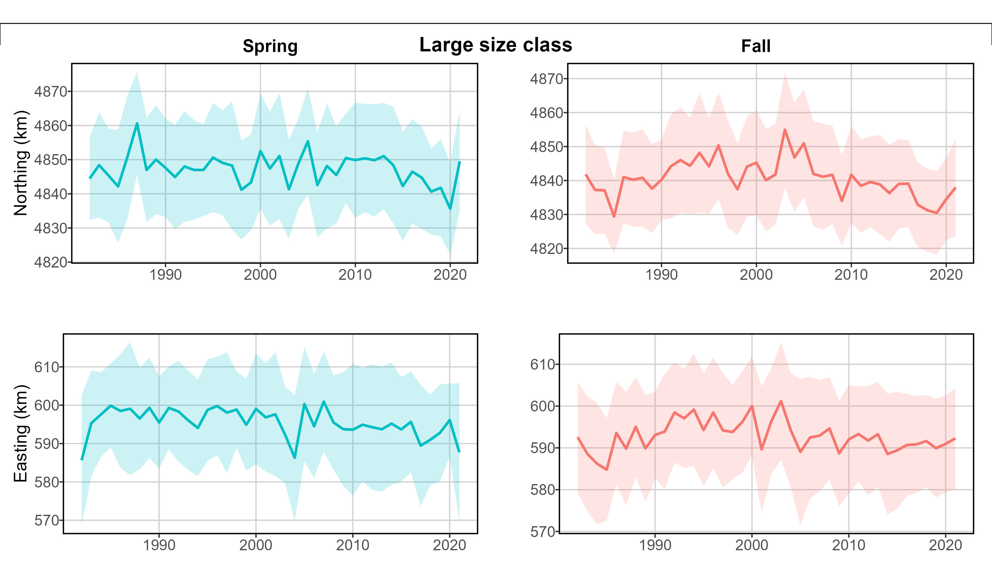
Split effective area occupied

Slide 28
Disclaimer: following maps have been created using previous model run, not the newest one

Slide 29
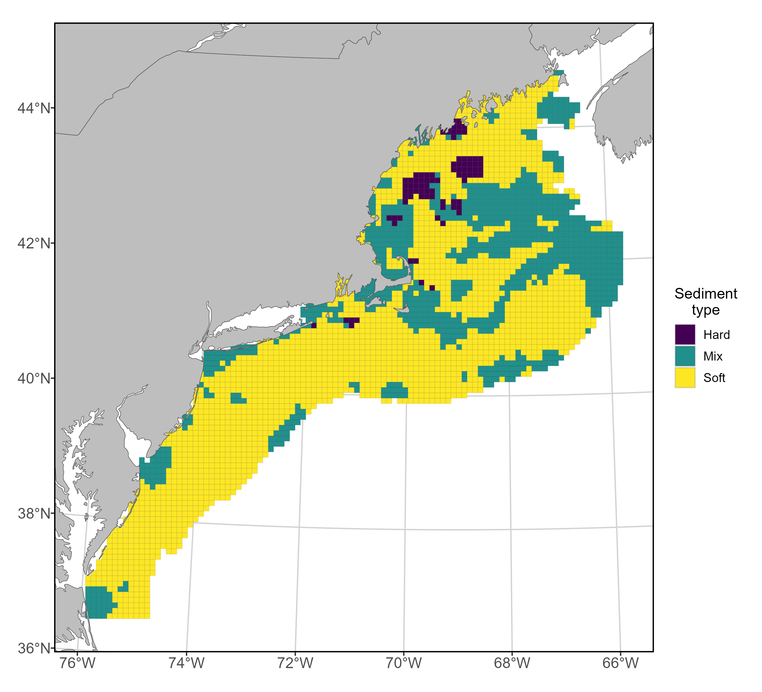
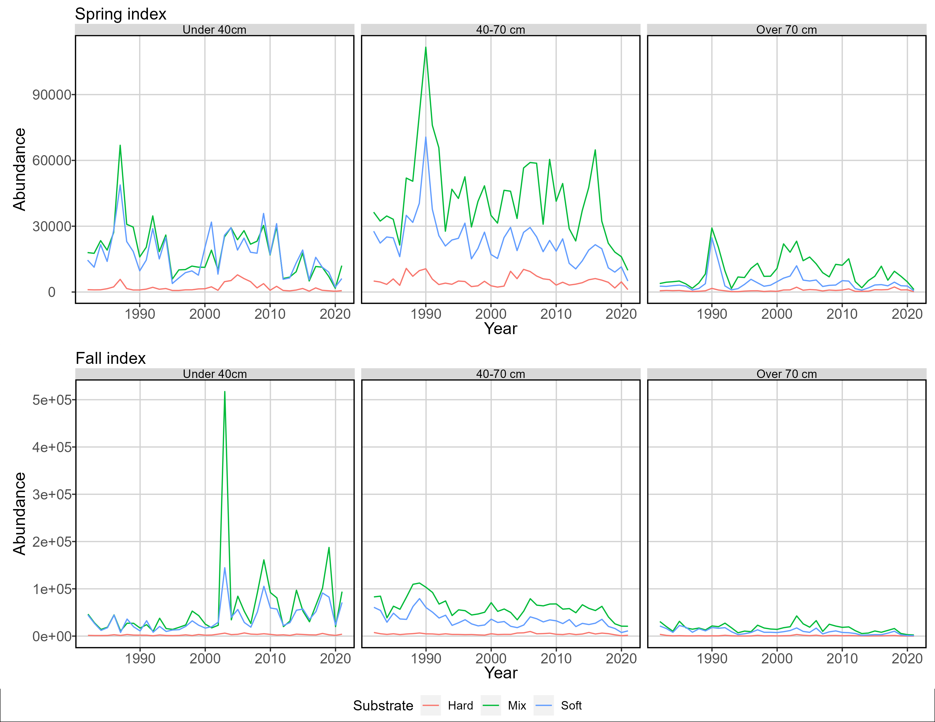
Seasonal sediment-based abundance

Slide 30
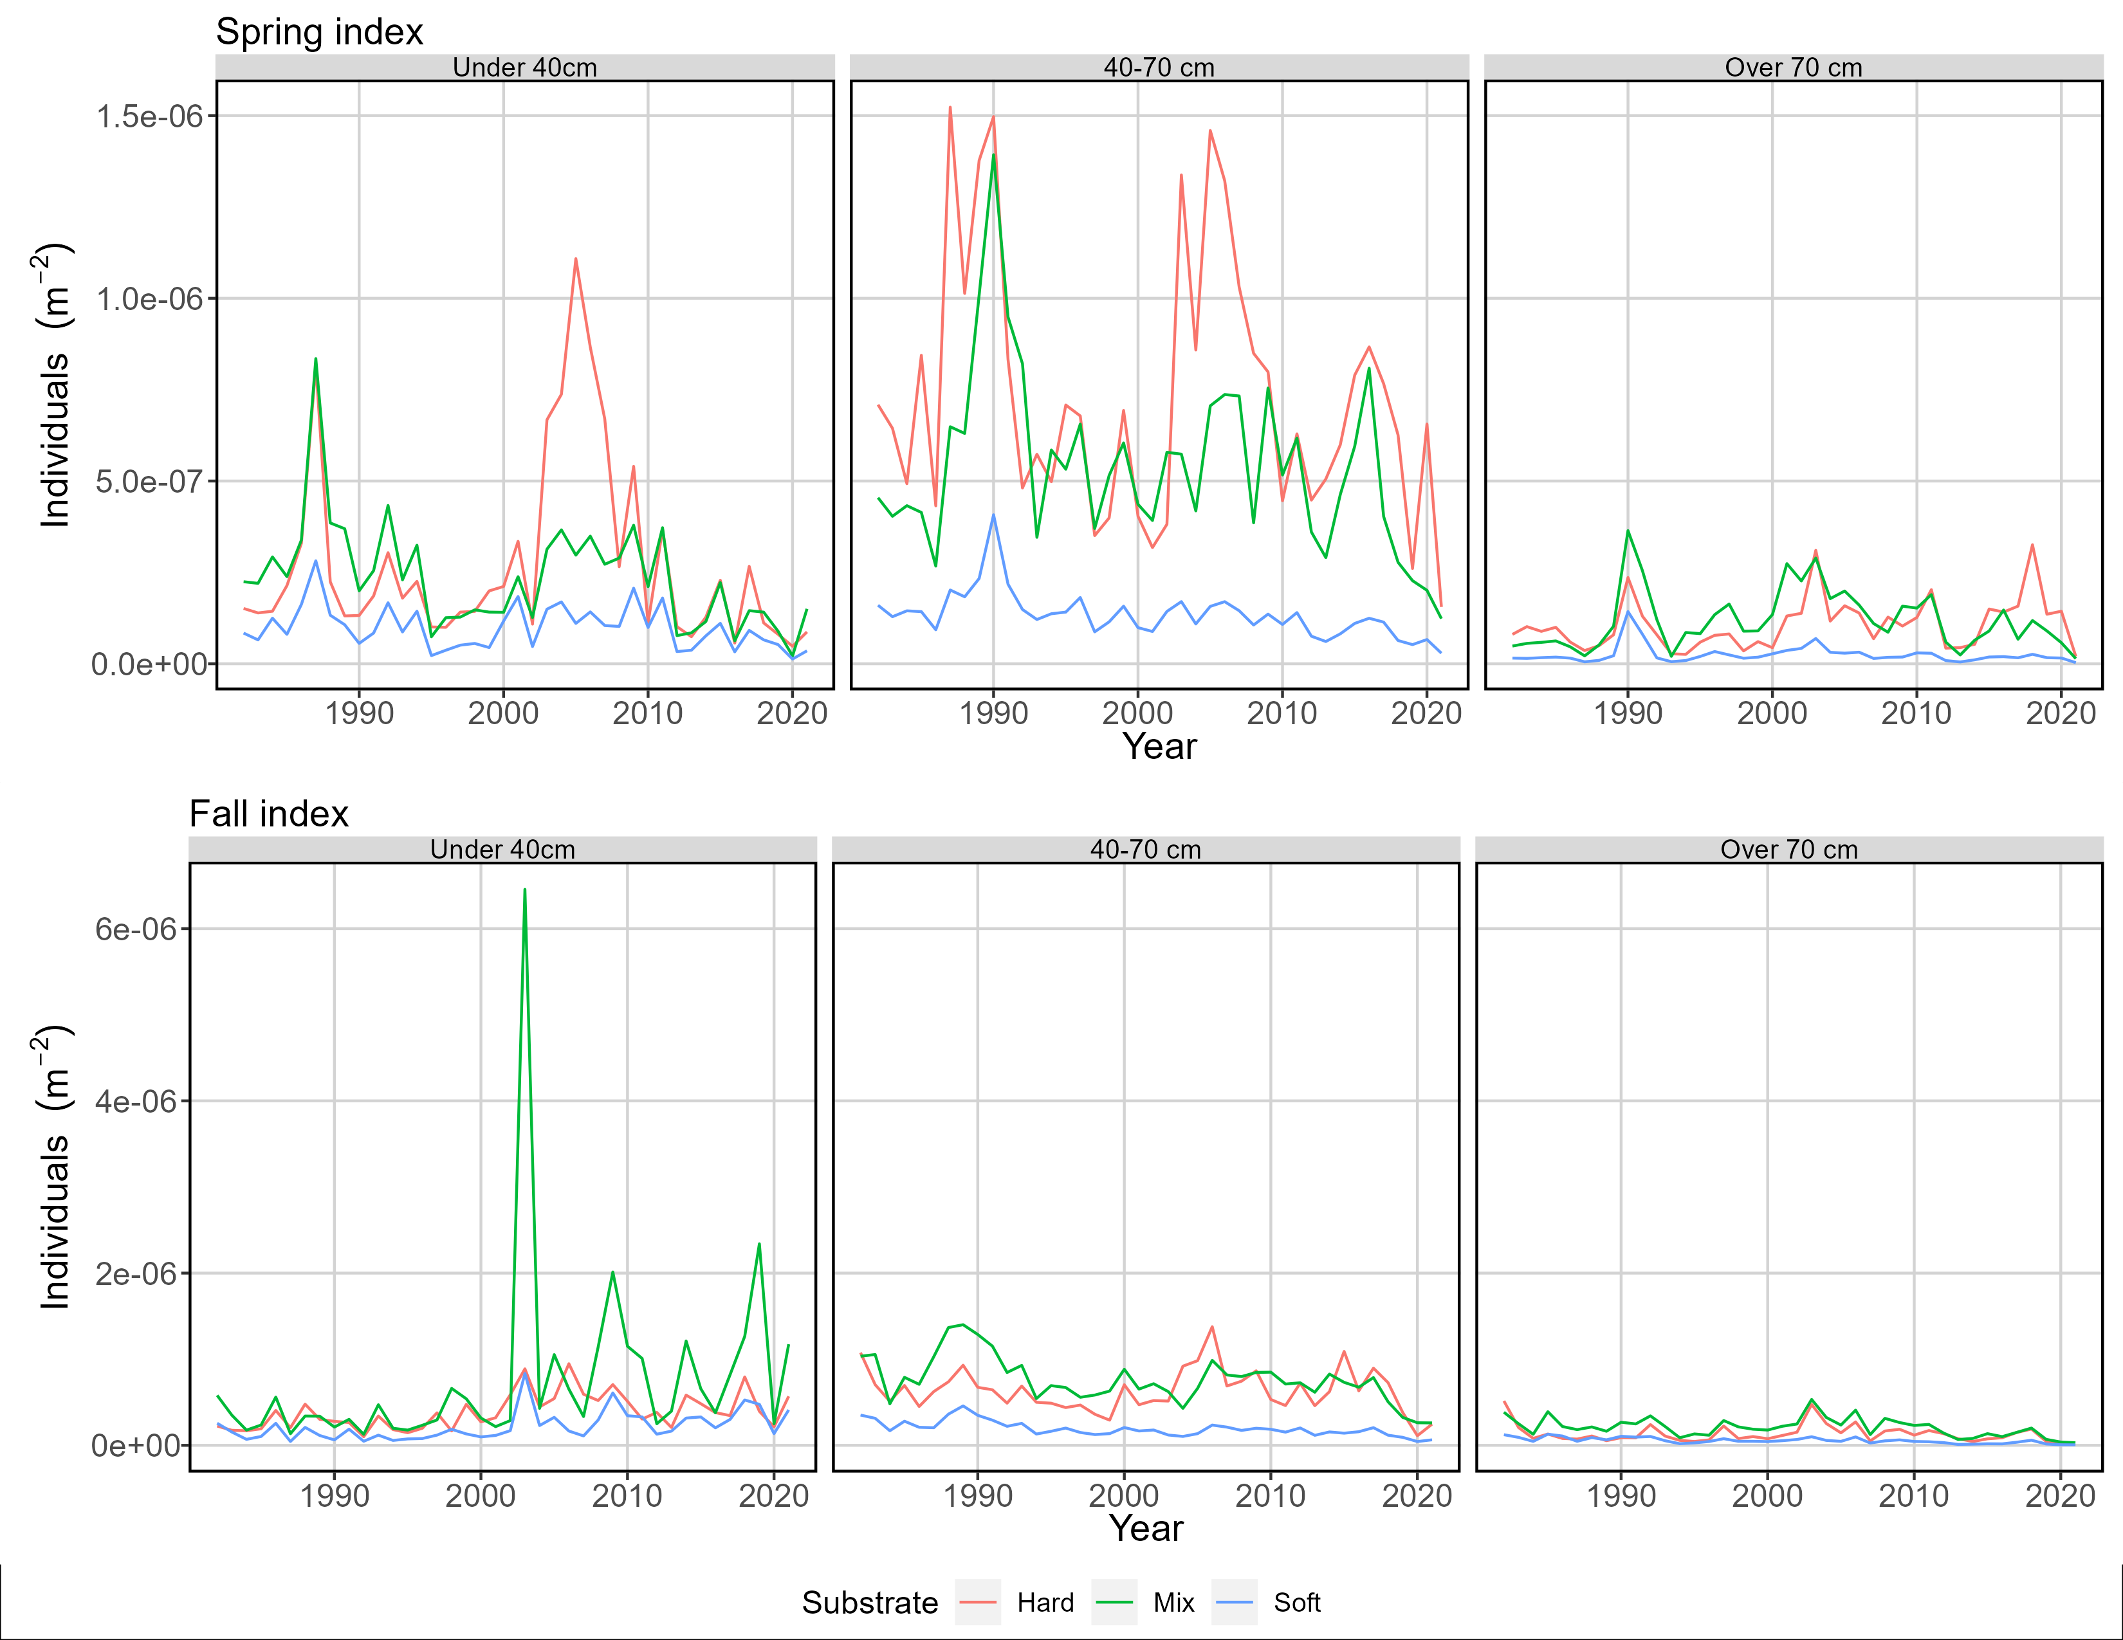
Seasonal sediment-based density

Slide 31
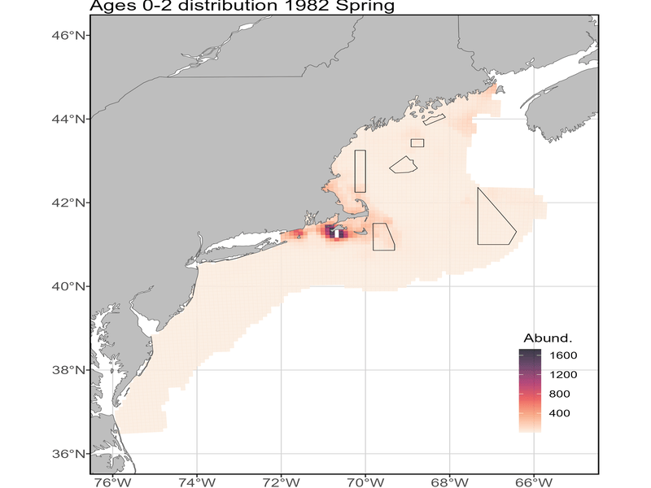
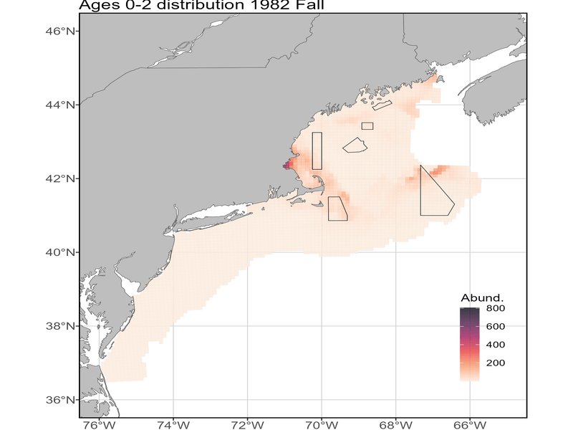
Split spatial density

Slide 32
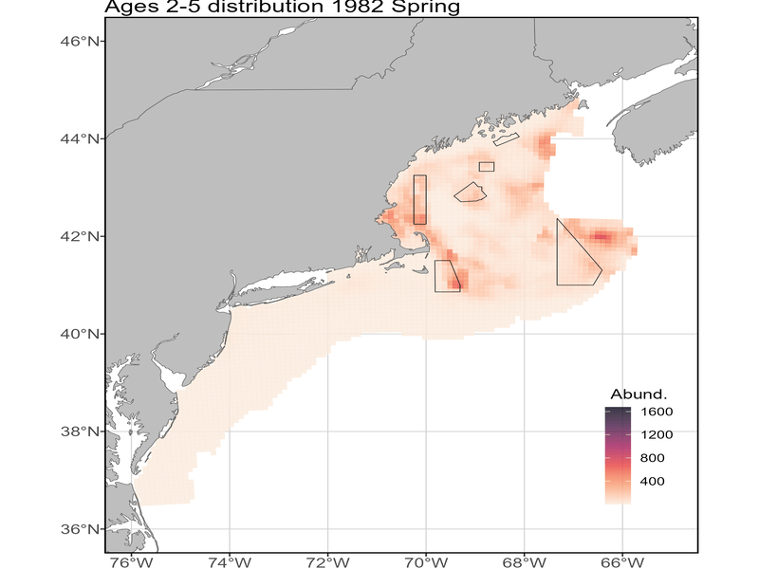

Split spatial density

Slide 33
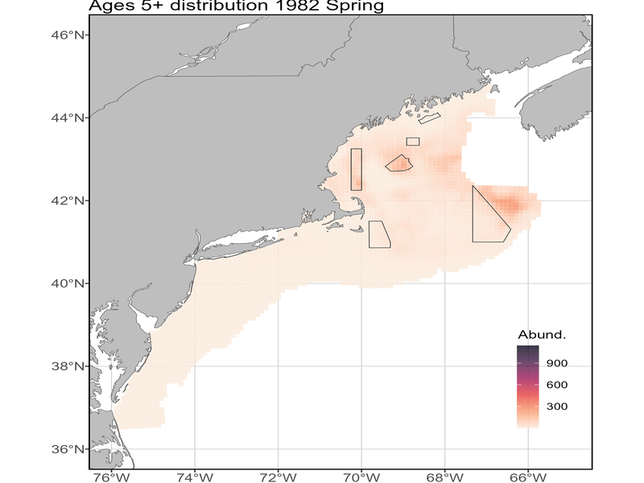
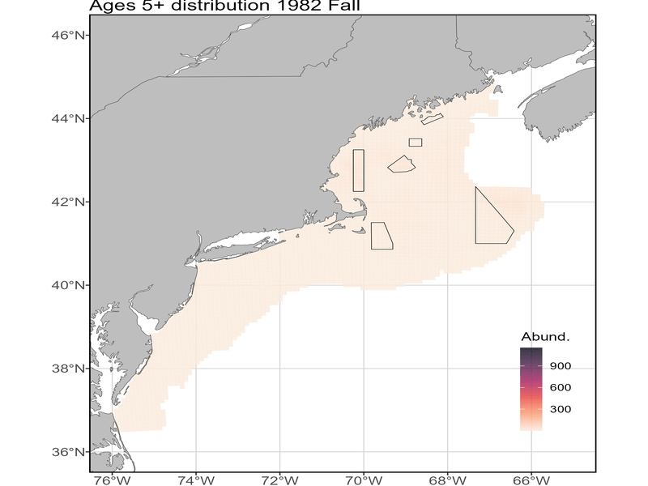
Split spatial density

Slide 34
Things that are still bothering me
Is there really a recruitment regime shift in the early 2000s?

Slide 35
Questions, Comments

Slide 36
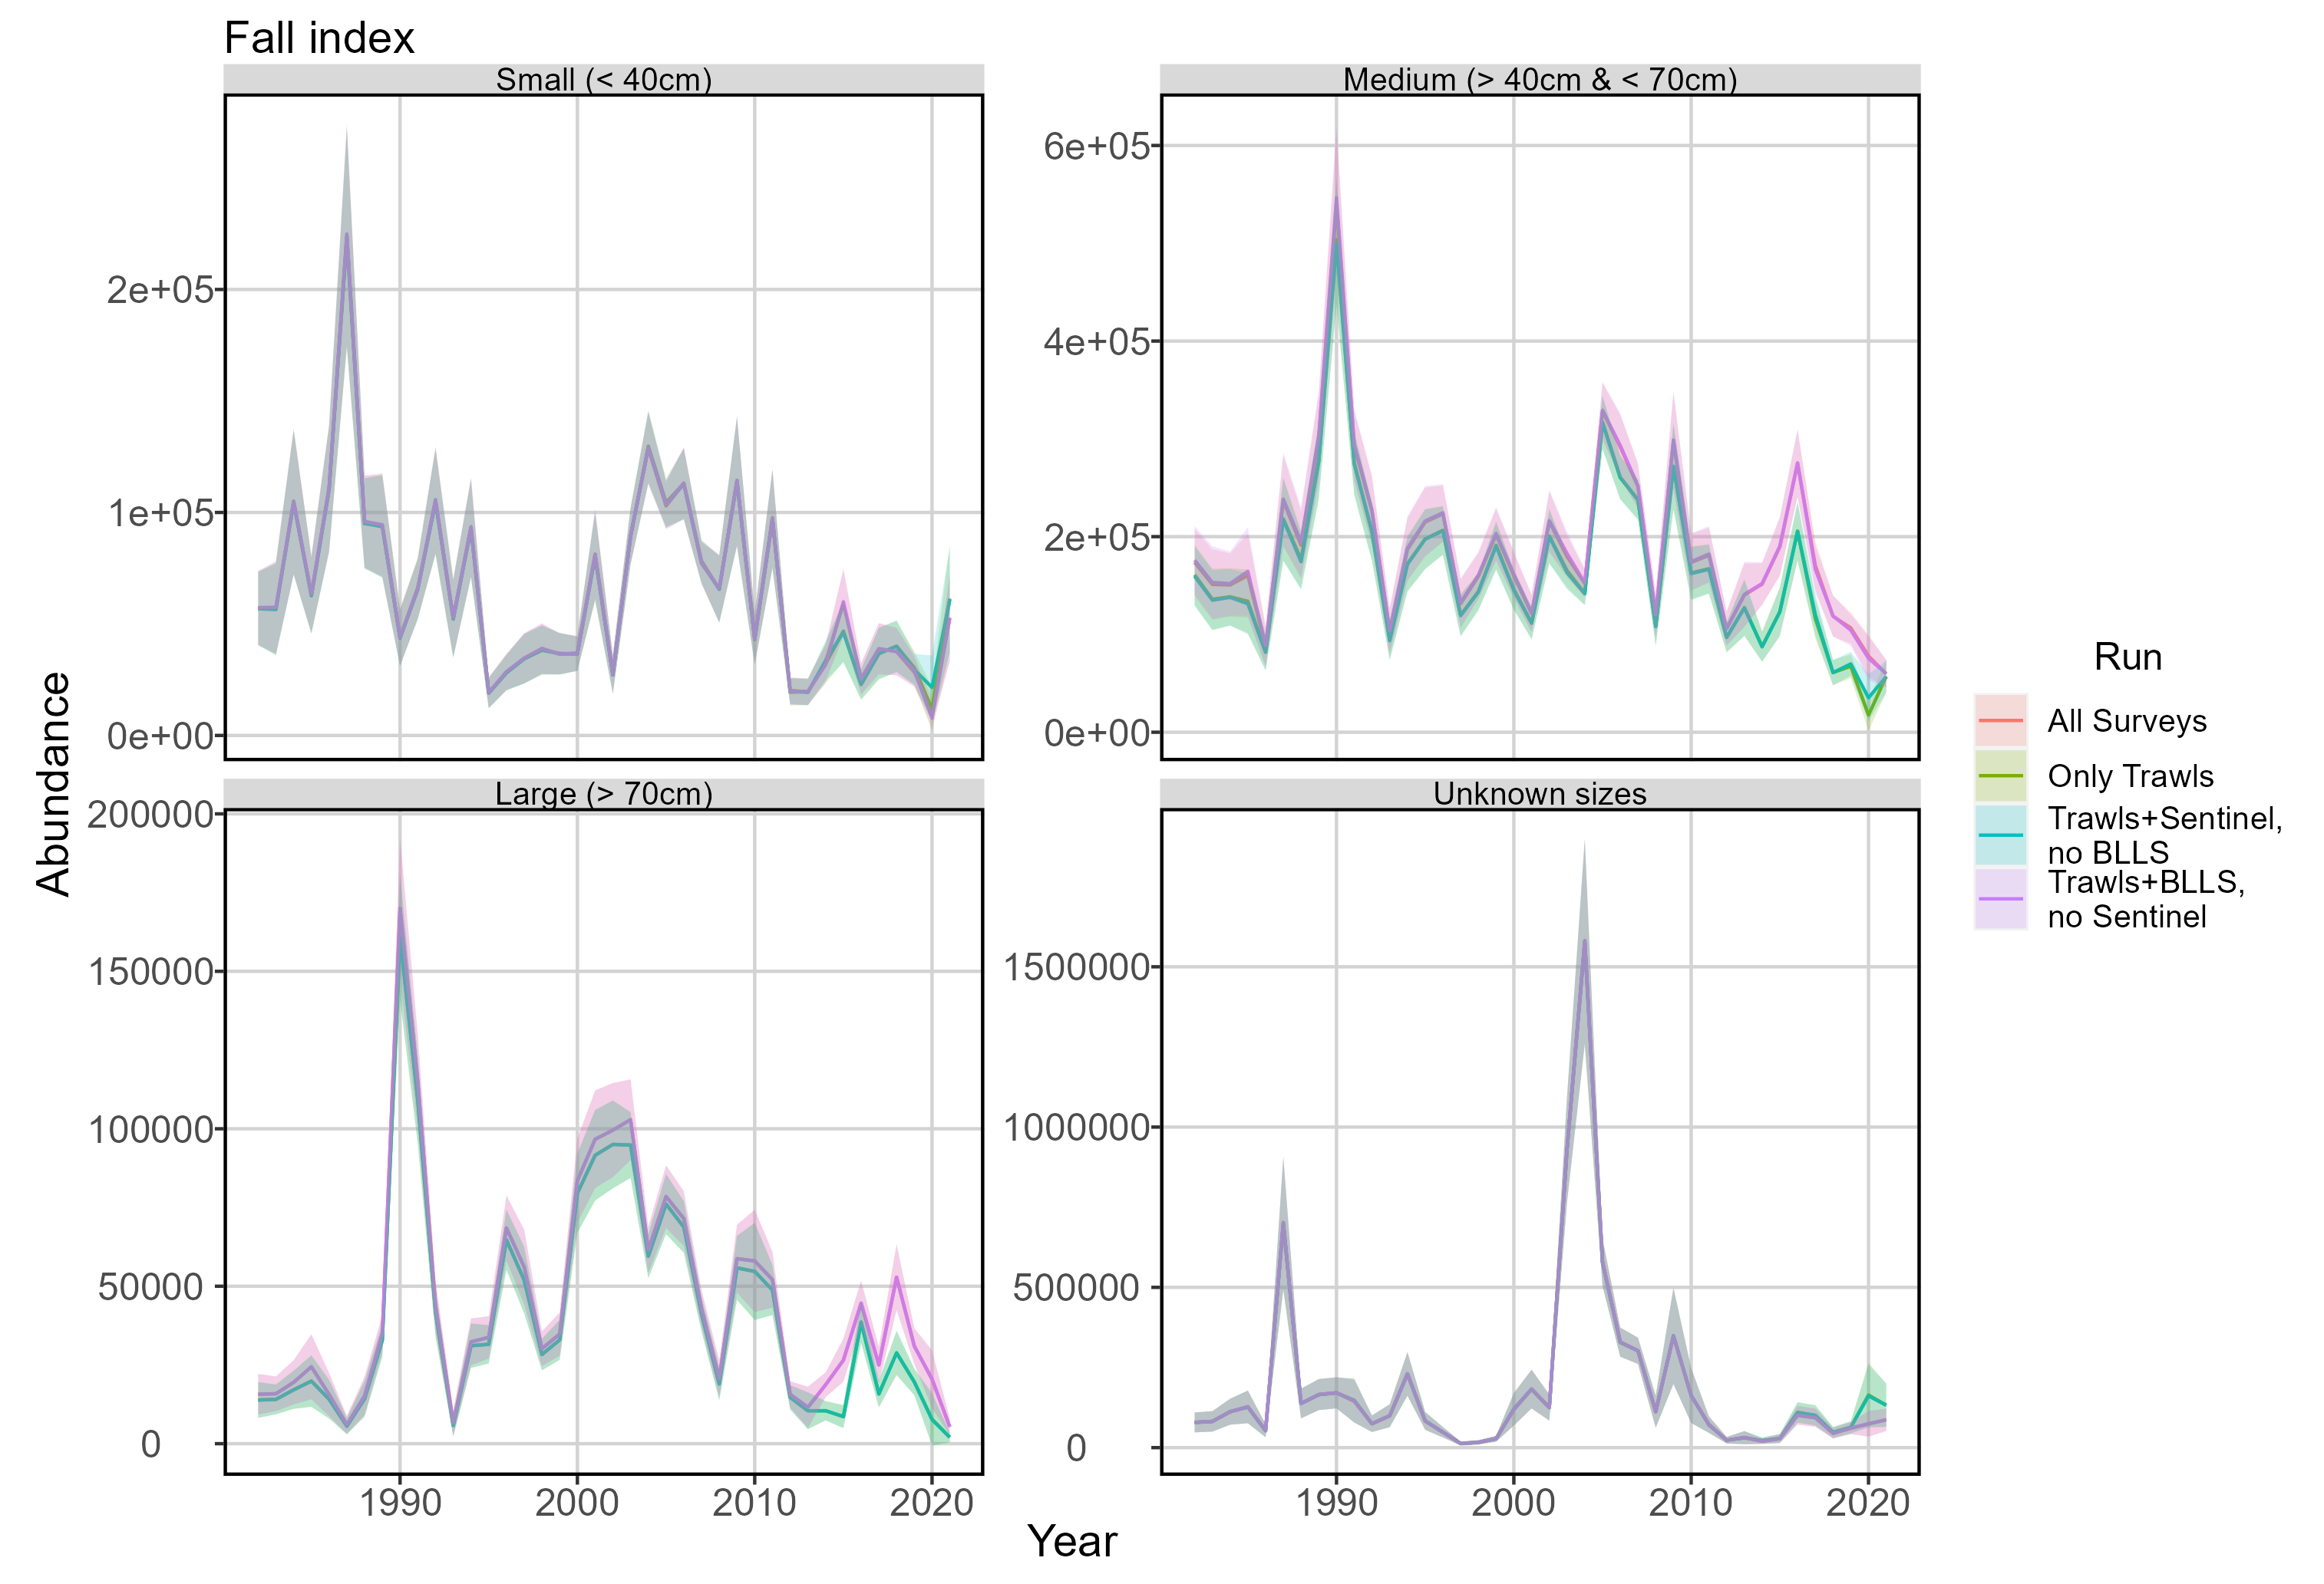
Model setup – gear sensitivity

Slide 37
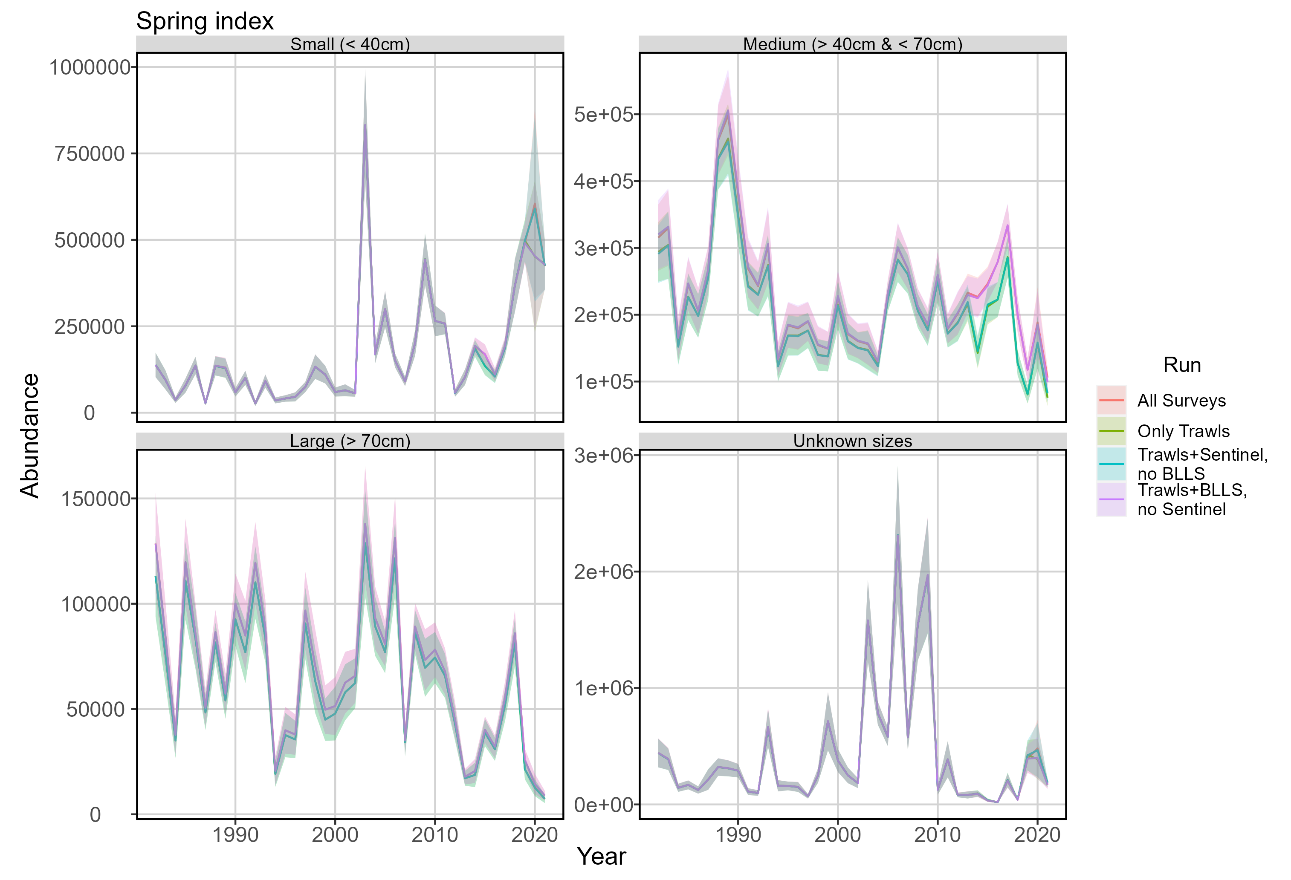
Model setup – gear sensitivity

